Slide 1
Simple Linear Regression

Slide 2
Contents
Probabilistic Models
Fitting the Model: The Least Squares Approach
Model Assumptions
Assessing the Utility of the Model: Making Inferences about the Slope β₁
The Coefficients of Correlation and Determination
Using the Model for Estimation and Prediction
A Complete Example
Notes:
As a result of this class, you will be able to...

Slide 3
Learning Objectives
Introduce the straight-line (simple linear regression) model as a means of relating one quantitative variable to another quantitative variable
Assess how well the simple linear regression model fits the sample data
Introduce the correlation coefficient as a means of relating one quantitative variable to another quantitative variable
Employ the simple linear regression model for predicting the value of one variable from a specified value of another variable
Notes:
As a result of this class, you will be able to...

Slide 4
11.1
Probabilistic Models
Notes:
:1, 1, 3

Slide 5
Models
Representation of some phenomenon
Mathematical model is a mathematical expression of some phenomenon
Often describe relationships between variables
Types
  Deterministic models
  Probabilistic models
Notes:
.

Slide 6
Deterministic Models
Hypothesize exact relationships
Suitable when prediction error is negligible
Example: force is exactly mass times acceleration
  F = m·a
© 1984-1994 T/Maker Co.

Slide 7
Probabilistic Models
Hypothesize two components
  Deterministic
  Random error
Example: sales volume (y) is 10 times advertising spending (x) + random error
  y = 10x + ε
  Random error may be due to factors
  other than advertising

Slide 8
General Form of Probabilistic Models
y = Deterministic component + Random error
where y is the variable of interest. We always assume that the mean value of the random error equals 0. This is equivalent to assuming that the mean value of y, E(y), equals the deterministic component of the model; that is,
E(y) = Deterministic component

Slide 9
A First-Order (Straight Line) Probabilistic Model
y = β₀ + β₁x +ε
where
y = Dependent or response variable
(variable to be modeled)
x = Independent or predictor variable
(variable used as a predictor of y)
E(y) = β₀ + β₁x = Deterministic component
ε (epsilon) = Random error component

Slide 10
A First-Order (Straight Line) Probabilistic Model
y = β₀ + β₁x +ε
β₀ (beta zero) = y-intercept of the line, that is, the point at which the line intercepts or cuts through the y-axis
β₁ (beta one) = slope of the line, that is, the change (amount of increase or decrease) in the deterministic component of y for every 1-unit increase in x

Slide 11
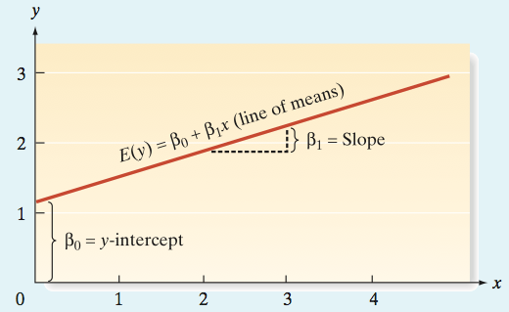
A First-Order (Straight Line) Probabilistic Model
[Note: A positive slope implies that E(y) increases by the amount β₁ for each unit increase in x. A negative slope implies that E(y) decreases by the amount β₁.]

Slide 12
Five-Step Procedure
Step 1: Hypothesize the deterministic component of the model that relates the mean, E(y), to the independent variable x.
Step 2: Use the sample data to estimate unknown parameters in the model.
Step 3: Specify the probability distribution of the random error term and estimate the standard deviation of this distribution.
Step 4: Statistically evaluate the usefulness of the model.
Step 5: When satisfied that the model is useful, use it for prediction, estimation, and other purposes.

Slide 13
11.2
Fitting the Model:
The Least Squares Approach
Notes:
:1, 1, 3

Slide 14
Scatterplot
Plot of all (x_{i}, y_{i}) pairs
Suggests how well model will fit
y
60
40
20
0
x
0
20
40
60

Slide 15
Thinking Challenge
How would you draw a line through the points?
How do you determine which line ‘fits best’?
y
60
40
20
0
x
0
20
40
60
Notes:
42

Slide 16
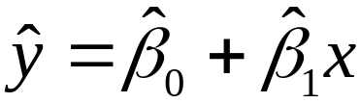
Least Squares Line
The least squares line is one that has the following two properties:
1. The sum of the errors equals 0,
i.e., mean error = 0.
2. The sum of squared errors (SSE) is smaller than for any other straight-line model, i.e., the error variance is minimum.

Slide 17
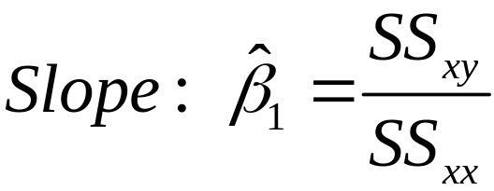
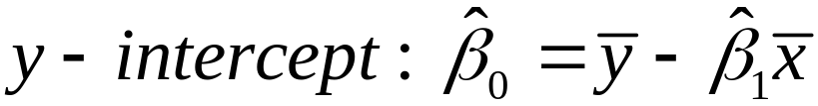
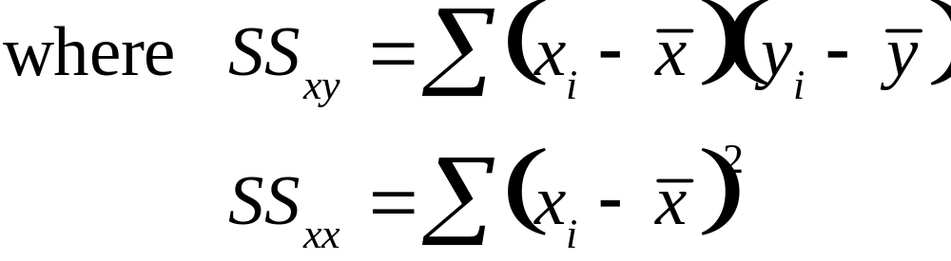
Formula for the Least Squares Estimates
n = Sample size

Slide 18


Interpreting the Estimates of β₀ and β₁ in Simple Liner Regression
y-intercept: represents the predicted value of y when x = 0 (Caution: This value will not be meaningful if the value x = 0 is nonsensical or outside the range of the sample data.)
slope: represents the increase (or decrease) in y for every 1-unit increase in x (Caution: This interpretation is valid only for x-values within the range of the sample data.)

Slide 19
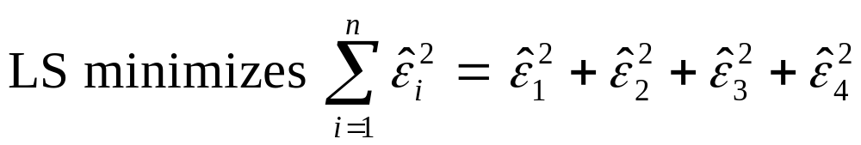
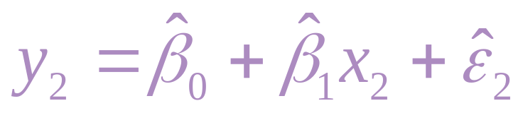
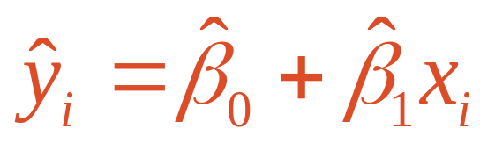
Least Squares Graphically
y
^
ε
^
4
ε
2
^
ε
^
ε
1
3
x
Notes:
52

Slide 20
Least Squares Example (reminder)
You’re a marketing analyst for Hasbro Toys. You gather the following data:
Ad Expenditure (100$) Sales (Units)
1 1
2 1
3 2
4 2
5 4
Find the least squares line relating
sales and advertising.

Slide 21
Scatterplot
Sales vs. Advertising
Sales
4
3
2
1
0
0
1
2
3
4
5
Advertising
Notes:
57

Slide 22
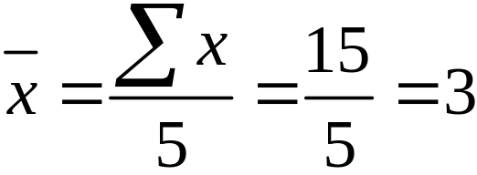
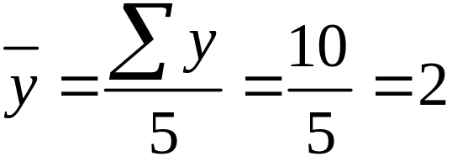
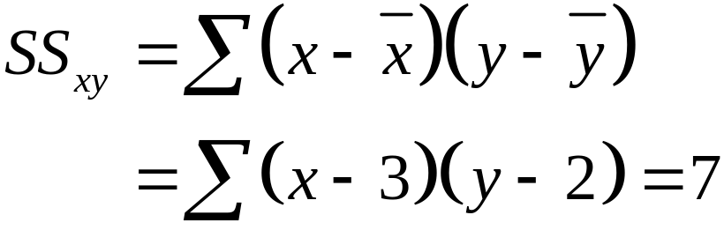
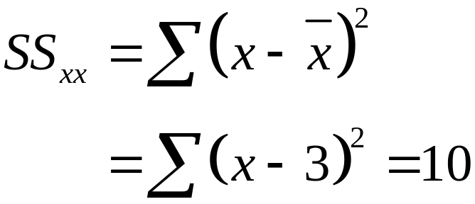
Parameter Estimation Solution
Notes:
59

Slide 23
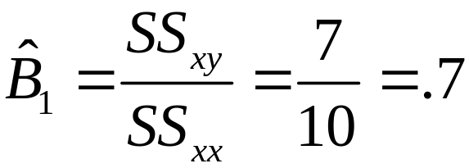
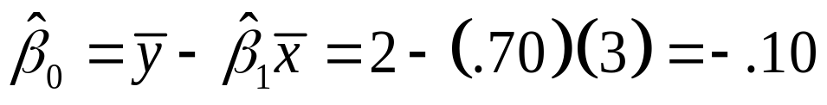
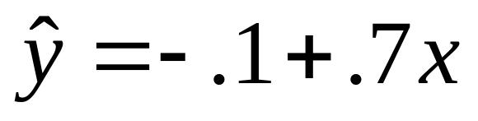
Parameter Estimation Solution
The slope of the least squares line is:
Notes:
59

Slide 24
Parameter Estimation Computer Output
Parameter Estimates
Parameter Standard T for H0:
Variable DF Estimate Error Param=0 Prob>|T|
INTERCEP 1 -0.1000 0.6350 -0.157 0.8849
ADVERT 1 0.7000 0.1914 3.656 0.0354
^
β₀
^
β₁

Slide 25
Coefficient Interpretation Solution
^
Slope (β₁)
  Sales Volume (y) is expected to increase by $700 for each $100 increase in advertising (x), over the sampled range of advertising expenditures from $100 to $500
^
y-Intercept (β₀)
  Since 0 is outside of the range of the sampled values of x, the y-intercept has no meaningful interpretation

Slide 26
11.3
Model Assumptions
Notes:
:1, 1, 3

Slide 27
Basic Assumptions of the Probability Distribution
Assumption 1:
The mean of the probability distribution of ε is 0 – that is, the average of the values of ε over an infinitely long series of experiments is 0 for each setting of the independent variable x. This assumption implies that the mean value of y, E(y), for a given value of x is
E(y) = β₀ + β₁x.

Slide 28
Basic Assumptions of the Probability Distribution
Assumption 2:
The variance of the probability distribution of ε is constant for all settings of the independent variable x. For our straight-line model, this assumption means that the variance of ε is equal to a constant, say σ ², for all values of x.

Slide 29
Basic Assumptions of the Probability Distribution
Assumption 3:
The probability distribution of ε is normal.
Assumption 4:
The values of ε associated with any two observed values of y are independent–that is, the value of ε associated with one value of y has no effect on the values of ε associated with other y values.

Slide 30
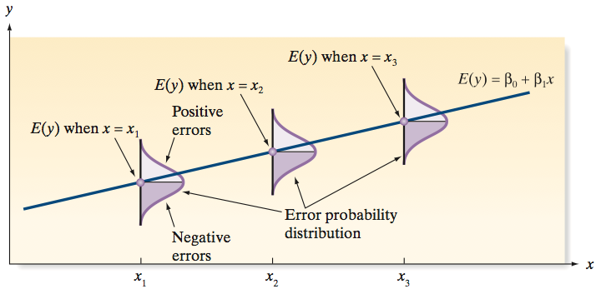
Basic Assumptions of the Probability Distribution
.

Slide 31
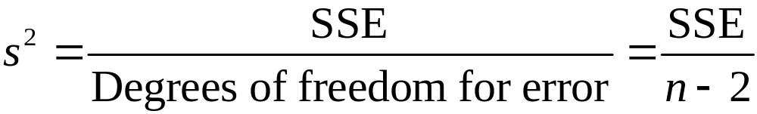
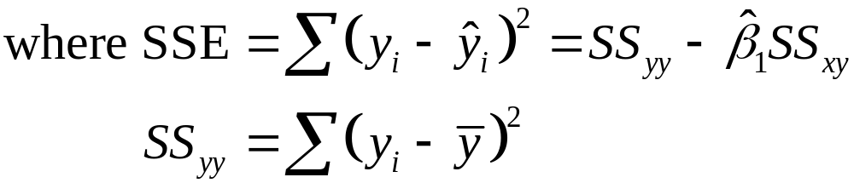
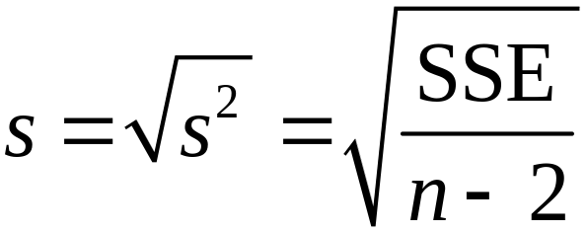
Estimation of σ ² for a (First-Order) Straight-Line Model
To estimate the standard deviation σ of ε, we calculate
We will refer to s as the estimated standard error of the regression model.

Slide 32
Calculating SSE, s², s Example
You’re a marketing analyst for Hasbro Toys. You gather the following data:
Ad Expenditure (100$) Sales (Units)
1 1
2 1
3 2
4 2
5 4
Find SSE, s², and s.

Slide 33
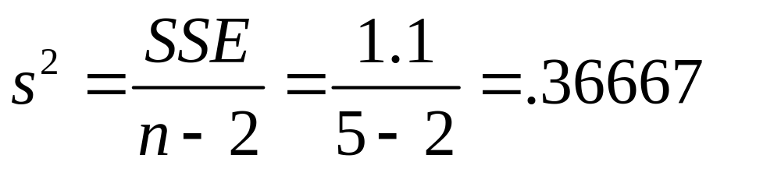
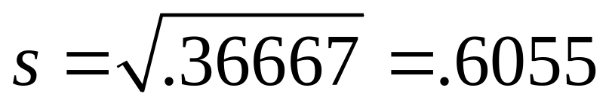
Calculating s² and s Solution

Slide 34
11.4
Assessing the Utility of the Model: Making Inferences about the Slope β₁
Notes:
:1, 1, 3

Slide 35

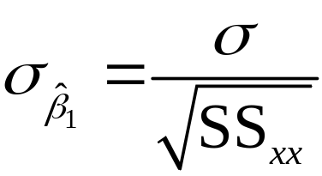
Sampling Distribution of
If we make the four assumptions about ε, the sampling distribution of the least squares estimator of the slope will be normal with mean β₁ (the true slope) and standard deviation

Slide 36
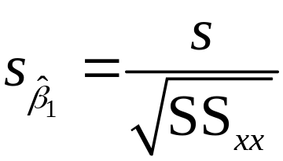

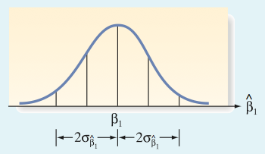
Sampling Distribution of
We estimate by and refer to this quantity as the estimated standard error of the least squares slope .

Slide 37
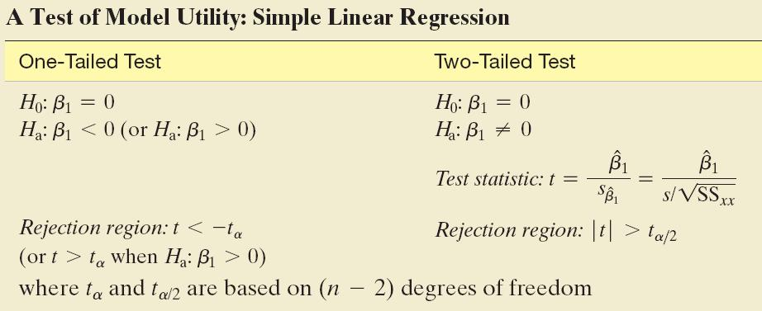
A Test of Model Utility: Simple Linear Regression

Slide 38
Interpreting p-Values for β Coefficients in Regression
Almost all statistical computer software packages report a two-tailed p-value for each of the β parameters in the regression model. For example, in simple linear regression, the p-value for the two-tailed test H₀: β₁ = 0 versus H_{a}: β₁ ≠ 0 is given on the printout. If you want to conduct a one-tailed test of hypothesis, you will need to adjust the p-value reported on the printout as follows:

Slide 39
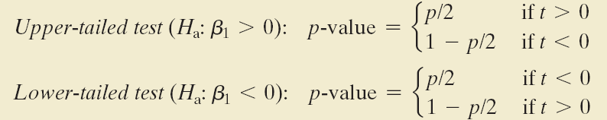
Interpreting p-Values for β Coefficients in Regression
where p is the p-value reported on the printout and t is the value of the test statistic.

Slide 40
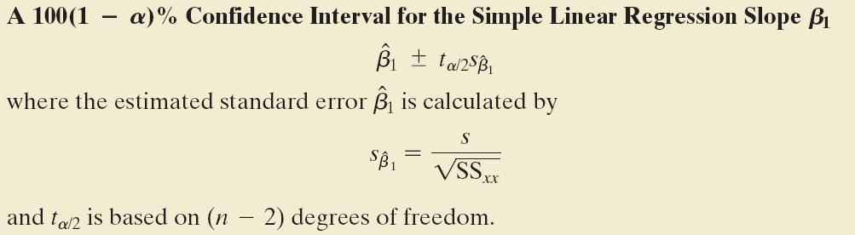

Slide 41

Test of Slope Coefficient Example
You’re a marketing analyst for Hasbro Toys.
You find β₀ = –.1, β₁ = .7 and s = .6055.
Ad Expenditure (100$) Sales (Units)
1 1
2 1
3 2
4 2
5 4
Is the relationship significant
at the .05 level of significance?
^
^

Slide 42
Test of Slope Coefficient
Solution
H₀:
H_{a}:
α =
df =
Critical Value(s):
β₁ = 0
β₁ ≠ 0
.05
5 – 2 = 3
Reject H₀
Reject H₀
.025
.025
-3.182
0
3.182
t
Notes:
109

Slide 43
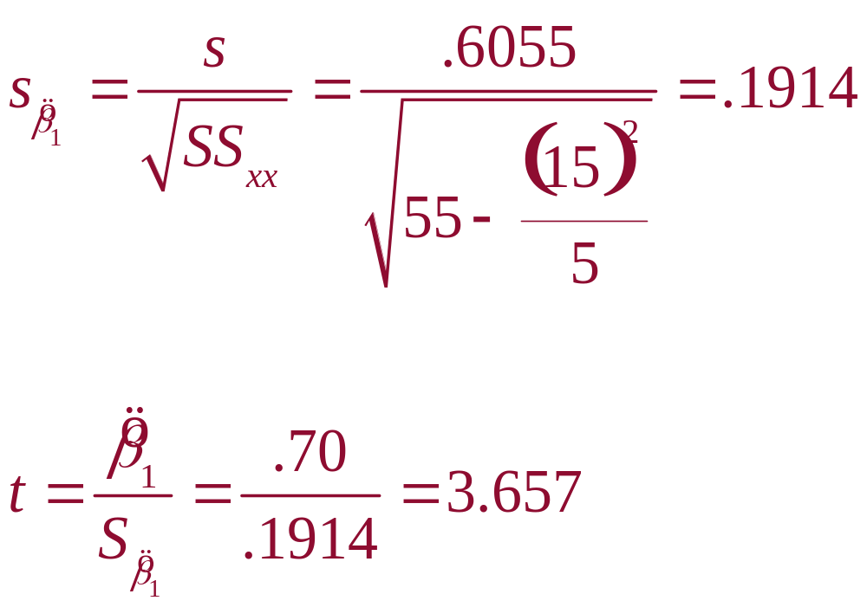
Test Statistic
Solution

Slide 44

Test of Slope Coefficient
Solution
H₀:
H_{a}:
α =
df =
Critical Value(s):
Test Statistic:
Decision:
Conclusion:
β₁ = 0
β₁ ≠ 0
.05
5 – 2 = 3
Reject H₀
Reject H₀
Reject at α = .05
.025
.025
There is evidence of a relationship
-3.182
0
3.182
t
Notes:
109

Slide 45
Test of Slope Coefficient
Computer Output
Parameter Estimates
Parameter Standard T for H0:
Variable DF Estimate Error Param=0 Prob>|T|
INTERCEP 1 -0.1000 0.6350 -0.157 0.8849
ADVERT 1 0.7000 0.1914 3.656 0.0354
^
S_{β}
^
^
t = β₁ / S_{β}
β₁
^
₁
₁
P-Value
Notes:
‘Standard Error’ is the estimated standard deviation of the sampling distribution, s_{bP}.

Slide 46
11.5
The Coefficients of Correlation and Determination
Notes:
:1, 1, 3

Slide 47
Correlation Models
Answers ‘How strong is the linear relationship between two variables?’
Coefficient of correlation
  Sample correlation coefficient denoted r
  Values range from –1 to +1
  Measures degree of association
  Does not indicate cause–effect relationship

Slide 48
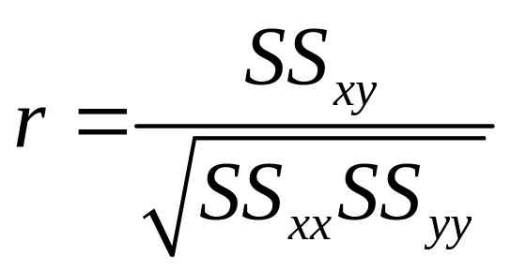
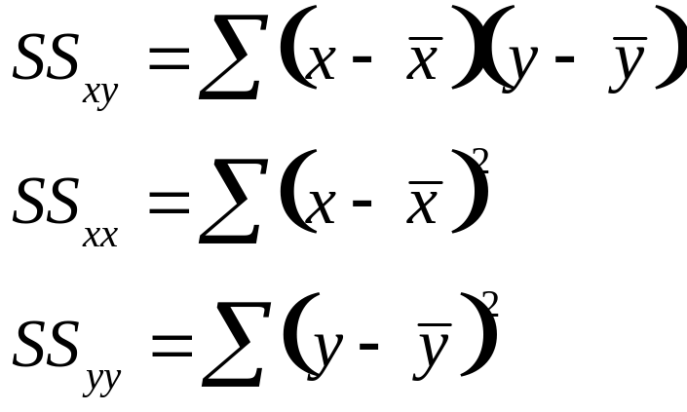
Coefficient of Correlation
where

Slide 49
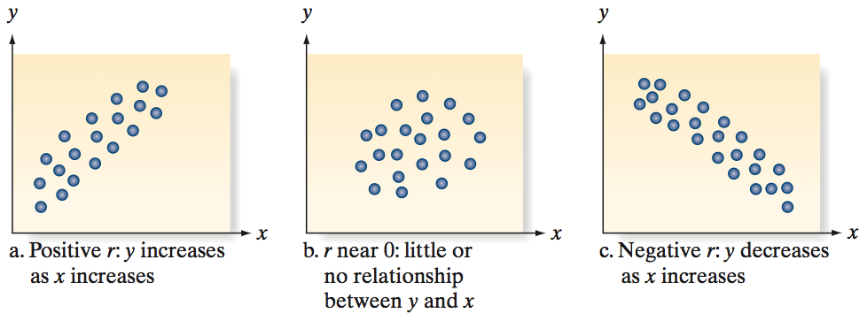
Coefficient of Correlation

Slide 50
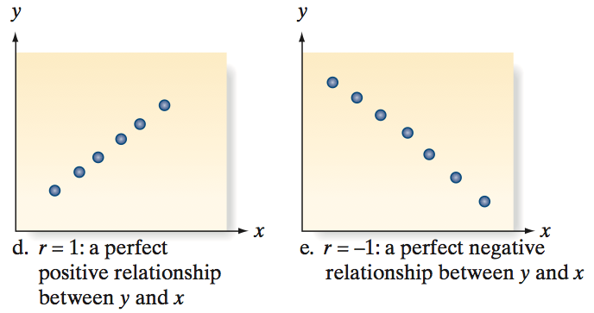
Coefficient of Correlation

Slide 51
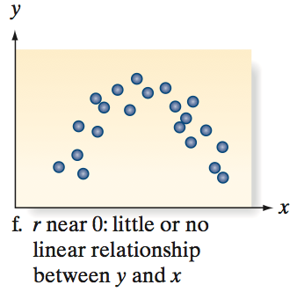
Coefficient of Correlation

Slide 52

Coefficient of Correlation Example
You’re a marketing analyst for Hasbro Toys.
Ad Expenditure (100$) Sales (Units)
1 1
2 1
3 2
4 2
5 4
Calculate the coefficient of
correlation.
Notes:
83

Slide 53
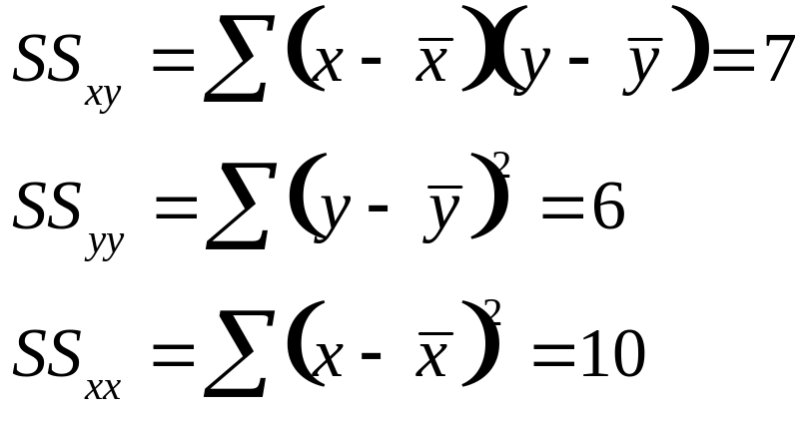
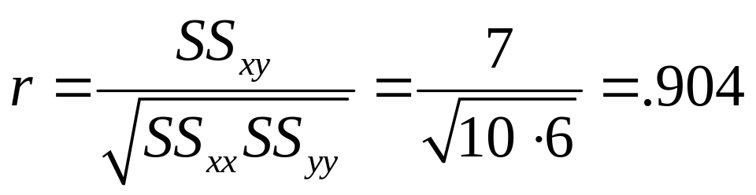
Coefficient of Correlation Solution

Slide 54
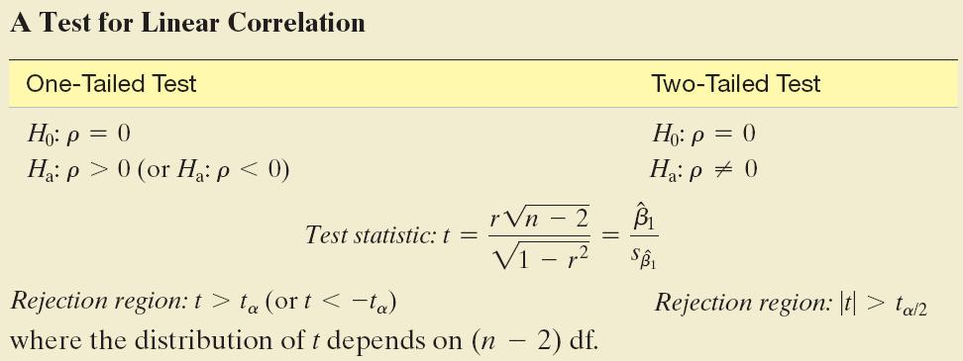
A Test for Linear Correlation

Slide 55
Condition Required for a Valid Test of Correlation
The sample of (x, y) values is randomly selected from a normal population.

Slide 56

Coefficient of Correlation Thinking Challenge
You’re an economist for the county cooperative. You gather the following data:
Fertilizer (lb.) Yield (lb.)
4 3.0
6 5.5
10 6.5
12 9.0
Find the coefficient of correlation.
© 1984-1994 T/Maker Co.
Notes:
62

Slide 57
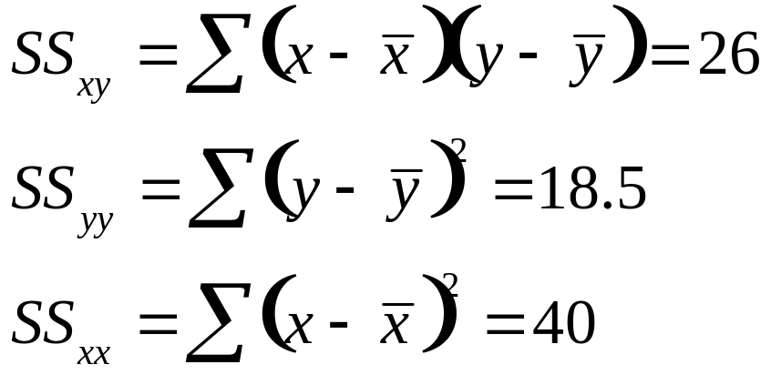
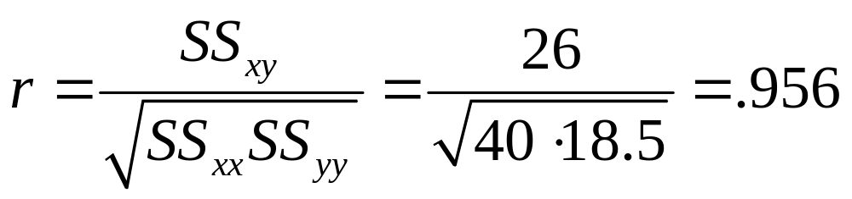
Coefficient of Correlation Solution

Slide 58
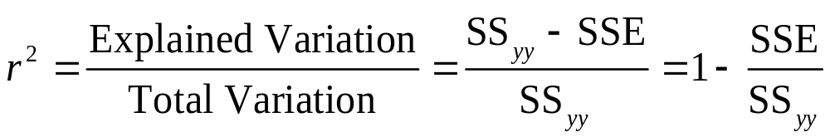

Coefficient of Determination
It represents the proportion of the total sample variability around y that is explained by the linear relationship between y and x.
0 ≤ r² ≤ 1
r² = (coefficient of correlation)²
Notes:
79

Slide 59

Coefficient of Determination Example
You’re a marketing analyst for Hasbro Toys. You know r = .904.
Ad Expenditure (100$) Sales (Units)
1 1
2 1
3 2
4 2
5 4
Calculate and interpret the
coefficient of determination.
Notes:
83

Slide 60
Coefficient of Determination Solution
r² = (coefficient of correlation)²
r² = (.904)²
r² = .817
Interpretation: About 81.7% of the sample variation in Sales (y) can be explained by using Ad $ (x) to predict Sales (y) in the linear model.
Notes:
83

Slide 61
r² Computer Output
Root MSE 0.60553 R-square 0.8167
Dep Mean 2.00000 Adj R-sq 0.7556
C.V. 30.27650
r²
r² adjusted for number of explanatory variables & sample size

Slide 62
11.6
Using the Model for Estimation and Determination
Notes:
:1, 1, 3

Slide 63
Probabilistic Model
Used to make inferences
  Estimate the mean value of y, E(y) for a specific x
    Estimate the mean sales for all months during which $400 (x = 4) is expended on advertising
  Predict a new individual y value for given x
    If we expend $400 in advertising next month, we want to predict the sales revenue for that month

Slide 64
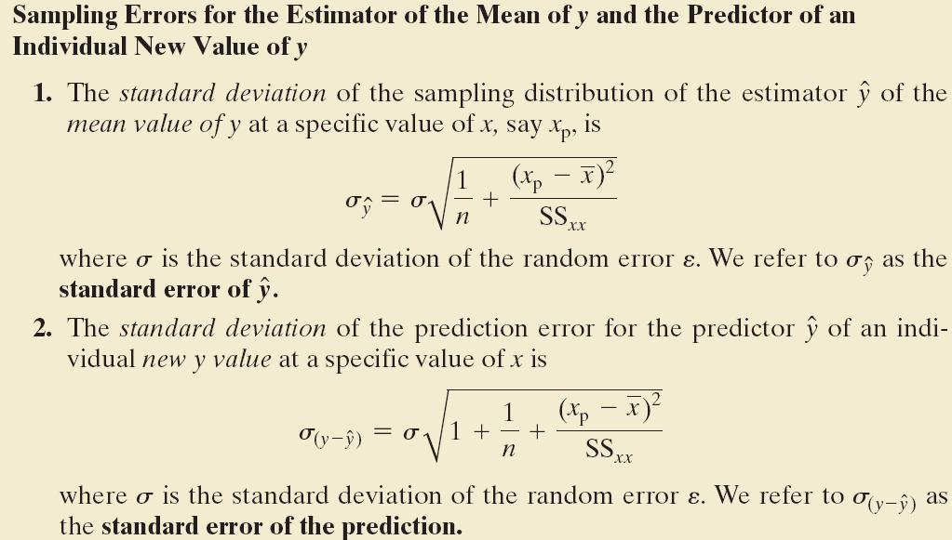

Slide 65
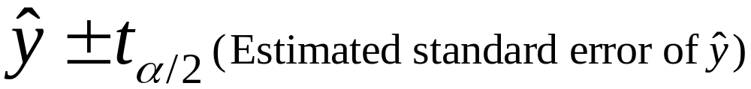
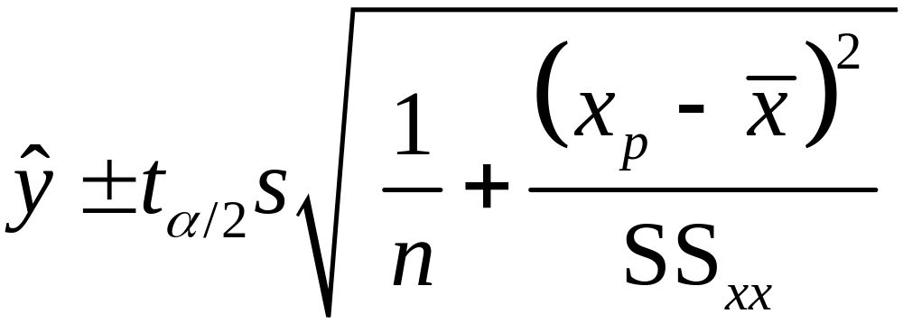
A 100(1 – α)% Confidence Interval for the Mean Value of y at x = x_{p}
df = n – 2

Slide 66
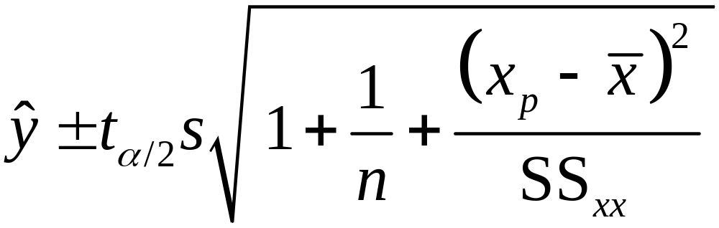
A 100(1 – α)% Prediction Interval for an Individual New Value of y at x = x_{p}
df = n – 2

Slide 67
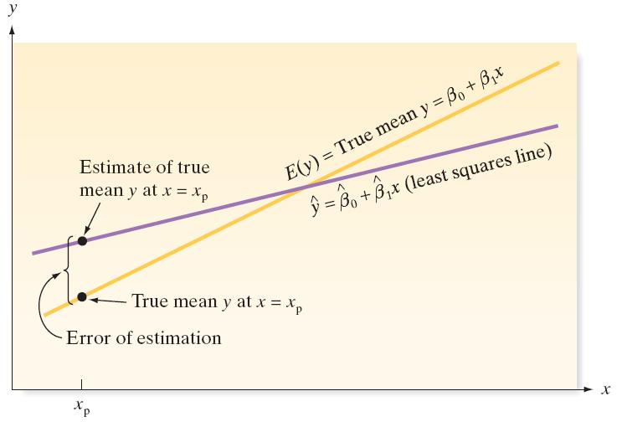
Error of estimating the mean value of y for a given value of x
Notes:
115

Slide 68
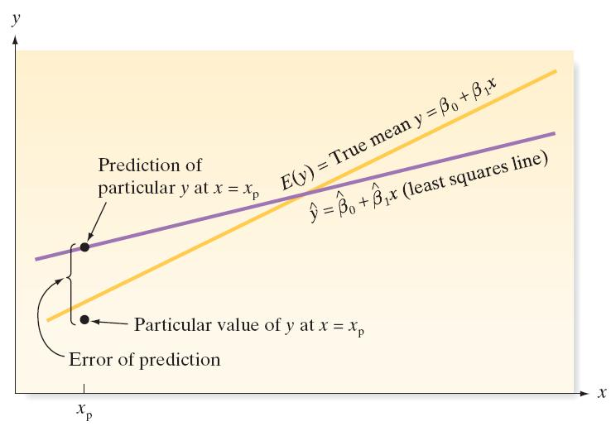
Error of predicting a future value of y for a given value of x
Notes:
115

Slide 69

Confidence Interval Example
You’re a marketing analyst for Hasbro Toys.
You find β₀ = –.1, β ₁ = .7 and s = .6055.
Ad Expenditure (100$) Sales (Units)
1 1
2 1
3 2
4 2
5 4
Find a 95% confidence interval for
the mean sales when advertising is $4.
^
^

Slide 70
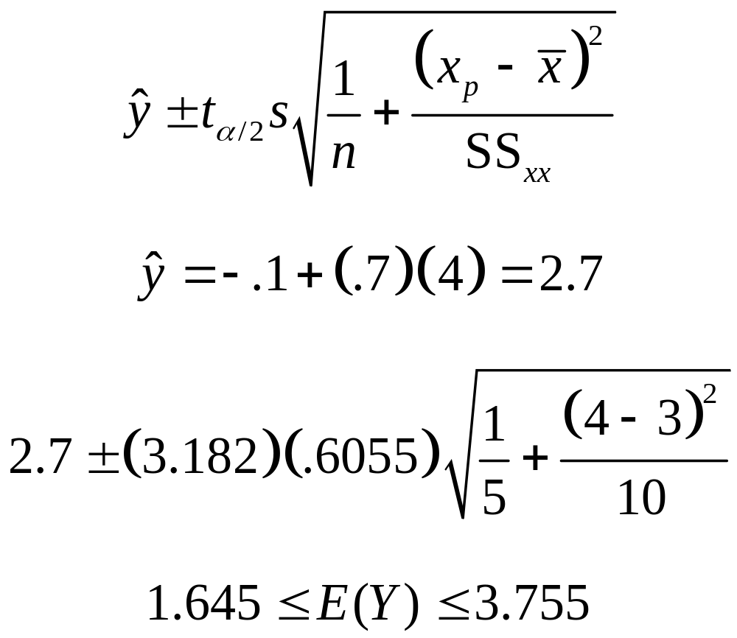
Confidence Interval Solution
x to be predicted
Notes:
121

Slide 71
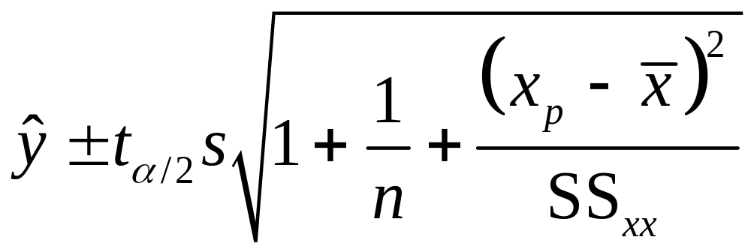
A 100(1 – α)% Prediction Interval for an Individual New Value of y at x = x_{p}
Note!
df = n – 2
Notes:
122
Note the 1 under the radical in the standard error formula.
The effect of the extra Syx is to increase the width of the interval.
This will be seen in the interval bands.

Slide 72
Why the Extra ‘S’?
y
y we're trying to
predict
^
^
y_{i} = β₀ + β₁x_{i}
^
ε
Expected
(Mean) y
E(y) = β₀ + β₁x
^
Prediction, y
x
x_{p}
Notes:
123
The error in predicting some future value of Y is the sum of 2 errors:
1. the error of estimating the mean Y, E(Y|X)
2. the random error that is a component of the value of
Y to be predicted.
Even if we knew the population regression line exactly, we would still make ε error.

Slide 73

Prediction Interval Example
You’re a marketing analyst for Hasbro Toys.
You find β₀ = –.1, β ₁ = .7 and s = .6055.
Ad Expenditure (1000$) Sales (Units)
1 1
2 1
3 2
4 2
5 4
Predict the sales when advertising
is $400. Use a 95% prediction interval.
^
^

Slide 74
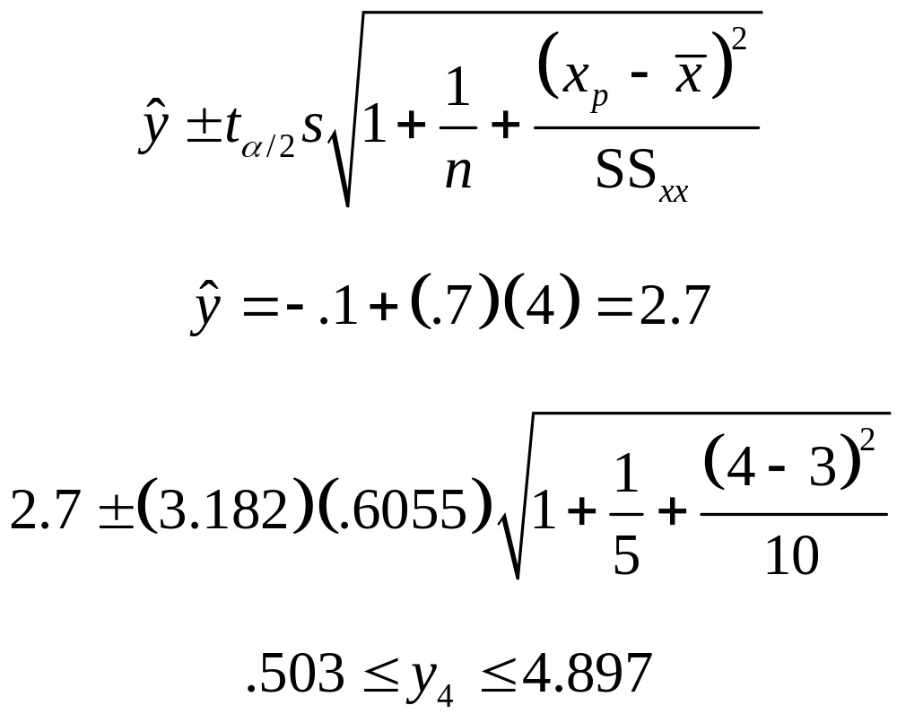
Prediction Interval Solution
x to be predicted
Notes:
121

Slide 75
Interval Estimate Computer Output
Dep Var Pred Std Err Low95% Upp95% Low95% Upp95%
Obs SALES Value Predict Mean Mean Predict Predict
1 1.000 0.600 0.469 -0.892 2.092 -1.837 3.037
2 1.000 1.300 0.332 0.244 2.355 -0.897 3.497
3 2.000 2.000 0.271 1.138 2.861 -0.111 4.111
4 2.000 2.700 0.332 1.644 3.755 0.502 4.897
5 4.000 3.400 0.469 1.907 4.892 0.962 5.837
Predicted y when x = 4
Confidence Interval
Prediction
Interval
S_{Y}
^

Slide 76
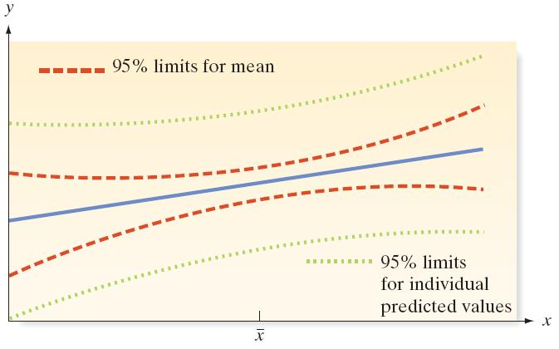
Confidence intervals for mean values and prediction intervals for new values
Notes:
115

Slide 77
11.7
A Complete Example
Notes:
:1, 1, 3

Slide 78
Example
Suppose a fire insurance company wants to relate the amount of fire damage in major residential fires to the distance between the burning house and the nearest fire station. The study is to be conducted in a large suburb of a major city; a sample of 15 recent fires in this suburb is selected. The amount of damage, y, and the distance between the fire and the nearest fire station, x, are recorded for each fire.

Slide 79
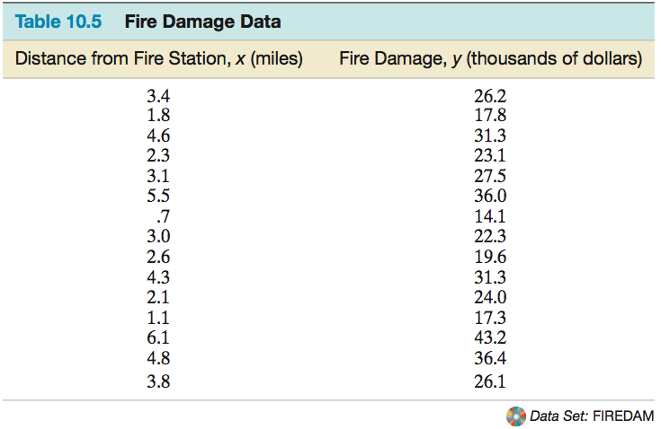
Example

Slide 80
Example
Step 1: First, we hypothesize a model to relate fire damage, y, to the distance from the nearest fire station, x. We hypothesize a straight-line probabilistic model:
y = β₀ + β₁x + ε

Slide 81

Example
Step 2: Use a statistical software package to estimate the unknown parameters in the deterministic component of the hypothesized model. The Excel printout for the simple linear regression analysis is shown on the next slide. The least squares estimates of the slope β₁ and intercept β₀, highlighted on the printout, are

Slide 82

Example

Slide 83

Example
This prediction equation is graphed in the Minitab scatterplot.

Slide 84


Example
The least squares estimate of the slope,
implies that the estimated mean damage increases by $4,919 for each additional mile from the fire station. This interpretation is valid over the range of x, or from .7 to 6.1 miles from the station. The estimated y-intercept, , has the interpretation that a fire 0 miles from the fire station has an estimated mean damage of $10,278.

Slide 85
Example
Step 3: Specify the probability distribution of the random error component ε. The estimate of the standard deviation σ of ε, highlighted on the Excel printout is
s = 2.31635
This implies that most of the observed fire damage (y) values will fall within approximately 2σ = 4.64 thousand dollars of their respective predicted values when using the least squares line.

Slide 86
Example
Step 4: First, test the null hypothesis that the slope β₁ is 0 –that is, that there is no linear relationship between fire damage and the distance from the nearest fire station, against the alternative hypothesis that fire damage increases as the distance increases. We test
H₀: β₁ = 0
H_{a}: β₁ > 0
The two-tailed observed significance level for testing is approximately 0.

Slide 87
Example
The 95% confidence interval yields (4.070, 5.768).
We estimate (with 95% confidence) that the interval from $4,070 to $5,768 encloses the mean increase (β₁) in fire damage per additional mile distance from the fire station.
The coefficient of determination, is r² = .9235, which implies that about 92% of the sample variation in fire damage (y) is explained by the distance (x) between the fire and the fire station.

Slide 88

Example
The coefficient of correlation, r, that measures the strength of the linear relationship between y and x is not shown on the Excel printout and must be
calculated. We find
The high correlation confirms our conclusion that β₁ is greater than 0; it appears that fire damage and distance from the fire station are positively correlated. All signs point to a strong linear relationship between y and x.

Slide 89
Example
Step 5: We are now prepared to use the least squares model. Suppose the insurance company wants to predict the fire damage if a major residential fire were to occur 3.5 miles from the nearest fire station. A 95% confidence interval for E(y) and prediction interval for y when x = 3.5 are shown on the Minitab printout on the next slide.

Slide 90

Example
Step 5: We are now prepared to use the least

Slide 91

Example
The predicted value (highlighted on the printout) is , while the 95% prediction interval (also highlighted) is (22.3239, 32.6672). Therefore, with 95% confidence we predict fire damage in a major residential fire 3.5 miles from the nearest station to be between $22,324 and $32,667.

